Slide 1
Internation Operations
Entry of Brigg and Stratton Corporation into a New International Market

Slide 2
Company Overview
Limited company established in 1908 by Stephen F. Briggs (inventor) and Harold M. Stratton.
The company is a leading designer, manufacturer, and marketer of pressure washers, lawn and garden mowers, turf care products, among other small engines for outdoor power equipment.
Its market extends across the globe with over 100 countries in 6 continents.

Slide 3
Company Overview
Total sales in 2017-2018 financial year was 1881.29 (million dollars) with 33% of the sales coming from international market, primarily Europe.
The company has 13 production facilities across the U.S while it runs oversea subsidiaries in Australia, China, Canada, Mexico, and Netherlands.

Slide 4
Lawnmower- a Product from Brigg and Stratton Corporation
Lawnmower, one of the leading product from the company is exported under the tariff code 8433/snowblower specifically 8433.11.00 where the rates of tariffs in trading blocs is free while for countries without free trade agreement with the U.S is 30%.
The export value for this product in 2017 was 150 million dollars with an export percentage share of 0.6% of the total exports from the U.S

Slide 5
New Market for Lawnmower

Slide 6
Brazil is a country with an unleashed potential for lawnmower market
An overview of its cultural aspects regarding lawns demonstrates limited existence of smartly done lawns partly due to the limited space in homes and also due to their culture where do it yourself is not the norm.
However, people are starting to appreciate smartly done gardens and are designing the naturally abundant vegetation but in most cases the work is being outsourced to cleaning and architectural designing companies who make use of lawnmowers, turf care products, tractors, among other machines.

Slide 7
Political and Economic Systems of Brazil
The political atmosphere between the U.S and Brazil had been a tense one and affect business cooperation between them.
The divergent views regarding the best way to deal with the Venezuelan economic crisis and the trade disputes over steel and ethanol were some of the contributing factors that had complicated economic relations between the two countries.
Free trade was non-existent between them and any trade was slapped with hefty tariffs.
After assuming office in 2016, President Michel Temer proposed economic reforms to reduce government spending and remove barriers to foreign investment.

Slide 8
Despite the lack of cooperation , America remained to be the third largest trading partner of Brazil after China and the European Union.
However in 2011,the two countries signed an Agreement on Trade and Economic Cooperation to enhance trade and Investment between them.
The agreement served to promote direct trade by providing framework for a number of issues, including innovation, trade facilitation and technical barriers to trade.
America is on the gain in these transactions, with Brazil registering back-to-back trade deficits. For example, last year America registered 27.0 billion US dollars surplus with Brazil.
.

Slide 9
. The country’s economic freedom score is 51.4, making it the 153rd freest economy in 2018.
The currency used in Brazil is he Brazilian real with one U.S dollar equaling 3.893 Brazilian reals. The real is subdivided into 100 centavos.

Slide 10
Intellectual Property Protection in Brazil
Brazil has had issues with the U.S regarding the high levels of piracy and counterfeiting of companies’ products.
While the patent rights of companies are regulated by the federal law, they are valid only in the U.S and thus are not recognized in Brazil.
Protection of a foreign intellectual property in Brazil requires registration by the National Institute of Industrial Property (“Instituto Nacional de Propriedade Industrial”- INPS). This facilitates royalties’ payments to foreign states and tax deductions

Slide 11
Reasons for selection of Brazil
The favorable climate and the vast natural vegetation potentiate the country for homes with good-looking and well-trimmed lawns.
Absence of well-established lawnmower producer company in the country.

Slide 12
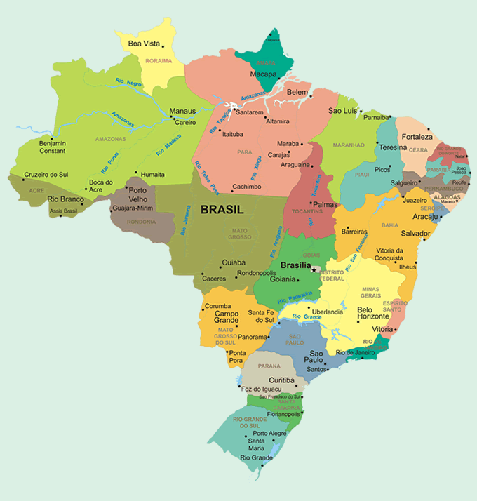
Photo of Brazil ( Retrieved from http://www.aboutbrasil.com/modules/brazil-brasil/Quick_facts_About_Brasil_Brazil.php?hoofd=9&sub=50&art=534)

Slide 13
The Potential Buyer in Brazil

Slide 14
The presumed new buyer in Brazil is Jr. Higienizacao Lmtda.
This is a limited company in Brazil established in 1973 whose line of doing business is provision of cleaning and conservation services across all the states in Brazil.
These services extend to front office and home lawns maintenance.

Slide 15
Reasons for Choosing Jr. Higienizacao Lmtda
The lawn mower products will greatly automate their services.
The company’s strategic policies of expanding its market allows incorporation of such service enhancing equipment that will attract more customers.

Slide 16
Recommendations
With the revolutionized economic system in Brazil, there is a health environment for Brigg and Stratton Corporation to expand their market for lawnmowers there.
The company should thus formulate its strategic plan and budget to commence business in this new foreign market.
Before then , the marketing branch should liaise with the foreign potential customer- Jr. Higienizacao Lmtda to ascertain their viability as new customers and their need of the lawnmower product.

Slide 17
References
Cavusgil, S. T., Knight, G., Riesenberger, J. R., Rammal, H. G., & Rose, E. L. (2014). International business. Pearson Australia.
Zander, I., McDougall-Covin, P., & Rose, E. L. (2015). Born globals and international business: Evolution of a field of research. Journal of International Business Studies, 46(1), 27-35.
Evans, P. B. (2018). Dependent development: The alliance of multinational, state, and local capital in Brazil. Princeton University Press.

